Slide 1
Introduction to C Programming I
Subject : COMP6047
ALGORITHM AND PROGRAMMING
Year : 2019

Slide 2
Learning Outcomes
At the end of this session, student will be able to:
Define element and structure of C programming language (LO1 & LO2)

Slide 3
Sub Topics
Introduction to C Programming:
History of C
C Standard Library
C Structure
Comments
Escape Sequences
Character
Identifier
Keywords

Slide 4
History of C
C evolved from two previous languages, BCPL and B.BCPL was developed in 1967 by Martin Richards
In 1970, Ken Thompson used B to create early versions of the UNIX operating system at Bell Laboratories
C language was evolved from B by Dennis Ritchie at Bell Laboratories and was originally implemented on DEC PDP-11 computer in 1972
The publication in 1978 of Kernighan and Ritchie’s book, The C Programming Language
1983 → X3J11 technical committee was created to make a standard of the language
1989 → Standard was approved
1999 → The standard was updated
C99 is a revised standard for the C programming language

Slide 5
Why Using C
Flexibility
Close to low level machine language yet easy to understand
Portability
Used from micro computer to super computer
A Well Known Programming Language
It is used in many forms of implementations such as O/S, scientific application, business application, etc.
Supported With a Large Number of Libraries

Slide 6
C Standard Library
When programming in C, you’ll typically use the following building blocks:
C Standard Library Functions
Example:
- <math.h> : Mathematical Functions
- <stdio.h> : Input and Output
- <stdlib.h> : Utility Functions
- <string.h> : String Functions
- <time.h> : Time and Date Functions
Functions you create yourself
Functions other people have created and made available to you

Slide 7
C Structure
C language is a structural programming language
It consists of functions
There is no separation between function and procedure (if you are from Pascal language background)
Each C program has one main function called main
Program will be started from the first line of the main function
C language is case sensitive
Every statement should be ended with a semi-colon (;)

Slide 8
C Structure
main()
{
statements;
}
main()
{
statements;
return(0);
}
1.
3.
void main()
{
statements;
}
int main()
{
statements;
return(0);
}
2.
4.

Slide 9
C Structure
However, not all C compiler is familiar with all main function format described previously
No. 3 and 4 would be a general/standard main function format
return(0), suggesting a normal program exit
A default integer (int) data type will be given for every function as a default. No. 3 and 4 have the same meaning
Example:
using Turbo C 2.0 (DOS) and Microsoft Visual C++ (windows) compiler, (2), (3) and (4) → success, but (1) warning
using Dev-C (windows) and gcc (linux) (1), (3), and (4) → success, but (2) warning

Slide 10
C Structure
Using Turbo C 2.0, the code will result in error.
Error Message:
Function should have a function prototype
int main()
{
printf (“Welcome to BINUS\n”);
return 0;
}
#include is a directive command to tell the computer to search for printf function prototype at header file stdio.h as well
#include<stdio.h>
int main()
{
printf (“Welcome to BINUS\n”);
return(0);
}

Slide 11
C Structure
Directive #include generally written at the beginning of a program
Coding Style (depends to the programmer)
#include<stdio.h>
int main()
{
printf (“Welcome to BINUS\n”);
return (0);
}
#include<stdio.h>
int main(){
printf (“Welcome to BINUS\n”);
return (0);
}

Slide 12
Comments
Used for readability of the program
Not accounted as a command/statement by the compiler
Using /* and */
Using // at the beginning of line for one line comment
Example:
/*--------------------------
My First Program
--------------------------*/
#include<stdio.h>
void main(){
printf (“Hello, BINUSIAN\n”);
}
// This program will simply print out a message

Slide 13
Escape Sequences
\a bell, alert, system beep
\b back space
\t horizontal tab
\n new line, line feed
\v vertical tab
\r carriage return
\’ single quote
\” double quote
\\ backslash
\xdd hexadecimal notation
\ddd octal notation

Slide 14
Character
C program is written using ASCII character subset:
Capital letters A…Z
Lower Case a…z
Digit 0…9
Special characters ‘!’, ‘&’, ‘+’, ‘\’, ‘_’, etc.
ASCII
American Standards Committee for Information Interchange
http://www.asciitable.com/

Slide 15
Identifier
The naming mechanism for various element in a program such as: variable, function, constant, etc.
Started with a letter or underscore_
It is case sensitive
Maximum length is vary for every compiler
Example: Turbo 2.0 (DOS), max 32 characters
Never use reserved word/keyword
(such as: for, while, if, main)
Example:
name, x1, _total, cubic()
wrong: 1time, int

Slide 16
Keywords
Keywords/reserved words are words that have special meaning to the C compiler.
Example:
Keywords added in C99
_Bool _Complex _Imaginary inline restrict
Keywords
auto break case char const continue default do | double else enum extern float for goto if | int long register return short signed sizeof static | struct switch typedef union unsigned void volatile while

Slide 17
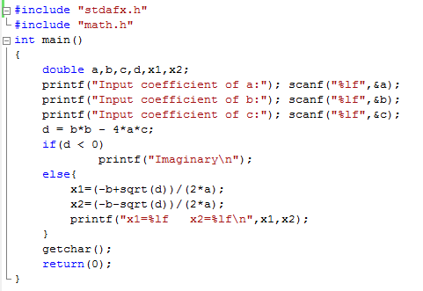
Keywords
Some compilers will highlight keywords with distinct color, as seen from the figure below
Keywords in Visual C++ use blue color

Slide 18
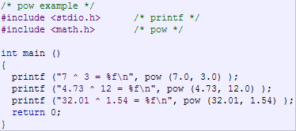

Sample Code
math.h example :

Slide 19
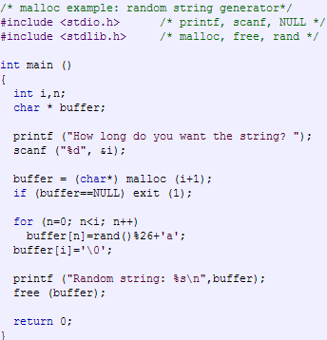
Sample Code
stdio.h & stdlib.h Sample :

Slide 20
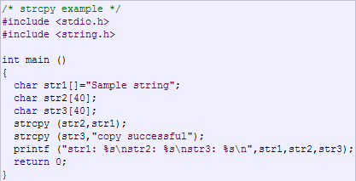

Sample Code
String.h Sample :

Slide 21
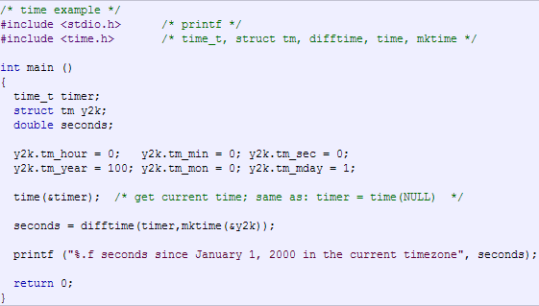
Sample Code
time.h example :

Slide 22
Exercise
State whether each of the following statements is TRUE or FALSE. If it is FALSE, explain why.
Every C program begins execution at main function
Comments cause the computer to print the text enclosed between /* and */ on the screen when the program is executed
All variables must be defined before used
All variables must be given a type when they’re defined
C considers number and Number to be identical

Slide 23
References
Paul Deitel & Harvey Deitel. (2016). C how to program : with an introduction to C++. 08. Pearson Education. Hoboken. ISBN: 9780133976892. Chapter 1 & 2
Writing Your First C Program: http://aelinik.free.fr/c/ch02.htm
Data Types and Names in C: http://aelinik.free.fr/c/ch04.htm

Slide 24
END

